Slide 1
Signals and Communication Systems (24EC2105)
Introduction to Communication Systems

Slide 2
Introduction to
Analog Communications

Slide 3
Analog Communications
What is Communication?
Communication Engineering is one of areas of Electrical Engineering that is concerned with the transfer of information from one location to another location.
Communication Systems use electrical / electronic energy to transmit information.
Electrical Energy can be transmitted
1. Directly over wire line
2. Radiated into the atmosphere, or
3. Transmitted via Satellite.

Slide 4
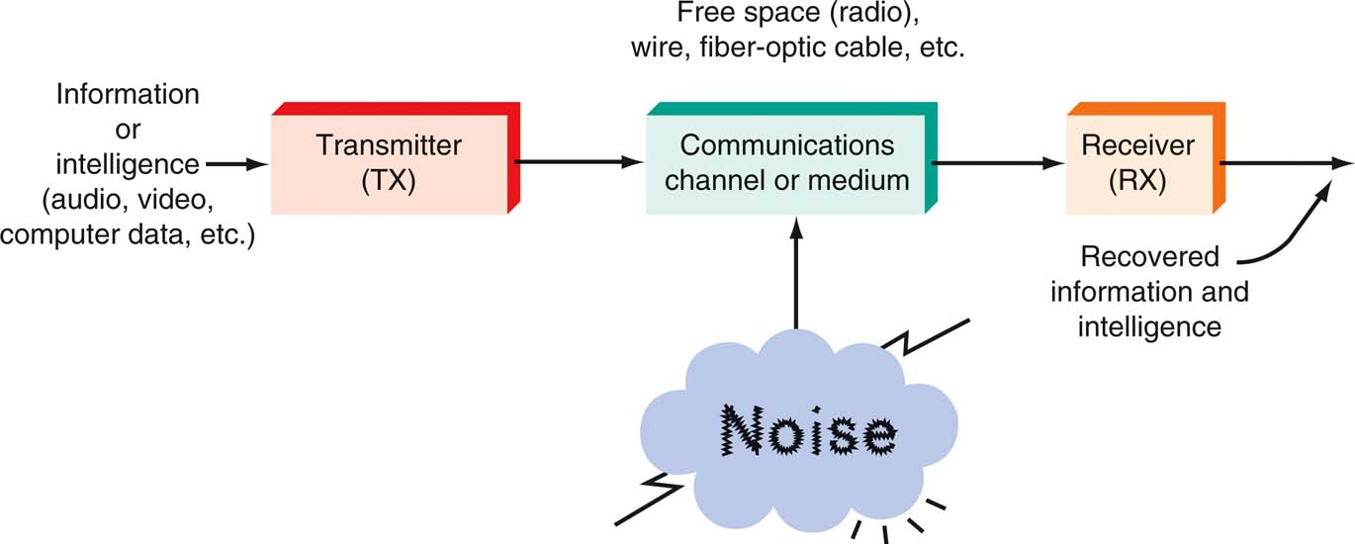
Communication Systems
A general model of all communication systems.

Slide 5
Applications of Commn. Systems
Telephone
Radio and Television
Cable TV (Including HDTV)
Wireless personal communications (Cellular phones, Beepers, Pagers et.,)
Internet.
Computer Networks (LAN and WAN)
Satellite / Deep space communication (Telemetry)
Under water communications.

Slide 6
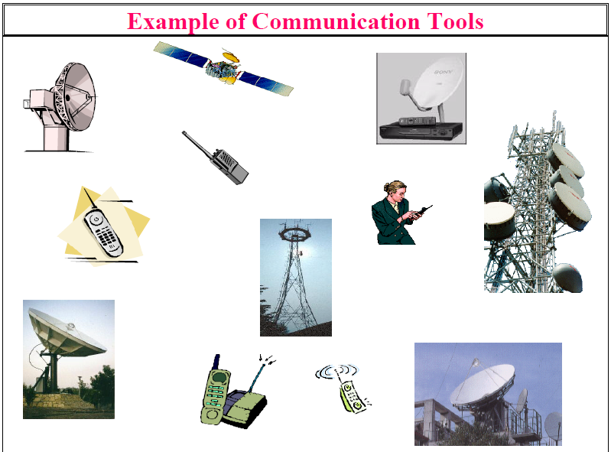

Slide 7
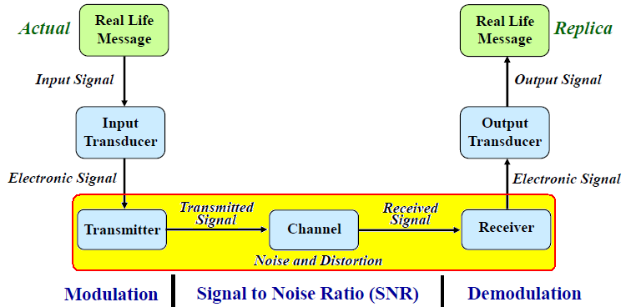

Basic Communication System
Three basic elements:
Transmitter: Converts message into a form suitable for transmission.
Channel: The physical medium, introduces distortion, noise, interference.
Receiver: Reconstruct a recognizable form of the message.

Slide 8
Modulation and Demodulation

Slide 9
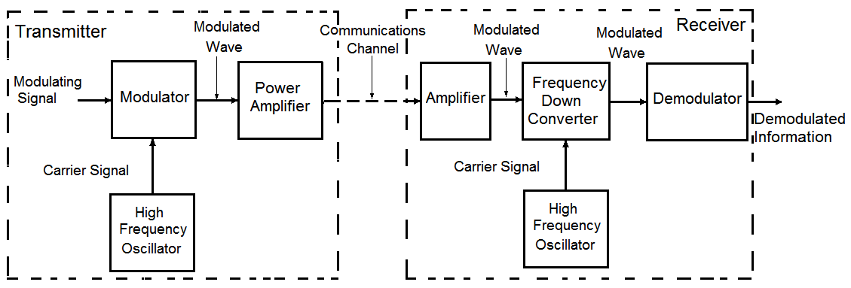
Modulation and Demodulation
Transmitter
Receiver
Channel
Modulation is a process that convert a message signal into a suitable form to transmit over a long distance through a communication channel.

Slide 10
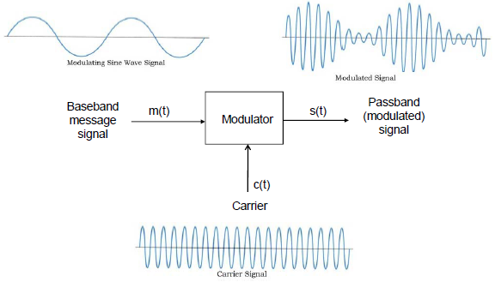
Modulation
The purpose of modulation is to convert the signal into a suitable form to match the transmission medium.
This is necessary because the message signal being a low frequency signal, that cannot be transmitted efficiently over the channel directly.

Slide 11
Need for Modulation
There are various reasons why modulation is necessary in electronic communication systems.
Ease of Radiation / Transmission: It is extremely difficult to radiate low frequency signals from an antenna in the form of electromagnetic energy.
For efficient radiation of electromagnetic energy, the radiating antenna should be in the order of a fraction or more of the wavelength of the driving signals.
For many baseband signals, the wavelengths are too large for reasonable antenna dimensions.

Slide 12
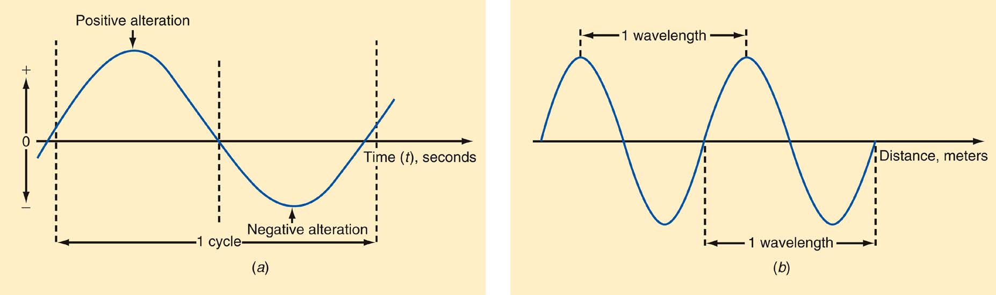
The Electromagnetic Spectrum
One wavelength
One Cycle
Frequency and wavelength. (a) One cycle. (b) One wavelength.
Number of crests per second is called frequency ‘f ‘ of the wave
The distance between successive crests is called Wavelength ‘ λ’ .
These two are related by an equation c = f λ where c = 3 X 10⁸ is velocity of light.

Slide 13
The Electromagnetic Spectrum
Frequency and Wavelength:
Wavelength (λ) = speed of light ÷ frequency
Speed of light = 3 × 10⁸ meters/second
Therefore: λ = 3 × 10⁸ / f
  Example:
  What is the wavelength of a signal if it’s frequency is 4MHz?
λ = 3 × 10⁸ / 4 MHz
= 75 meters (m)

Slide 14
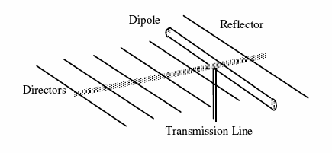
Ease of Radiation
Coupling of EM wave into space: Antenna size versus wavelength
Speech signal: 100 Hz to 3000 Hz
For 100 Hz:
For 3000 Hz
Antenna size of this length Practically Impossible
With modulation by high frequency say for example 10 MHz carrier wave, the antenna size is nearly 3 meters for ( ) practically feasible.

Slide 15
(b) Multiplexing: Simultaneous Transmission of Multiple Signals
Modulation allows multiple signals to be transmitted simultaneously between two points.
Modulation schemes enable one to multiplex a number of signals at the same time in a single channel without any interference themselves.
This multiplexing scheme is utilized in long distance telephony, data telemetry etc.
(c) Reduction of Noise:
The noise and other interference are two major limitations of any communication system.
These effects cannot be eliminated completely.
However, certain modulation schemes can suppress the noise and interference to some extent.

Slide 16
(d) Narrow banding: For example an audio range extends from say 50 Hz to 10⁴ Hz.
The ratio of the highest audio frequency to lowest is 200. Therefore the antenna size is either too short or too long.
Suppose that by modulation, the audio spectrum is translated into the range from (10⁵+50) to (10⁵+10⁴).
Then the ratio of the highest frequency to lowest is 1.01.
Hence the modulation is useful to process the wide range of signals.

Slide 17
Need for modulation…
(e) Channel Matching: Modulation is used to make sure that the message signal conforms to the limitations of its channel.
(f) Modulation is used to place the signals at desired frequency band (translation) for signal processing purposes such as filtering, amplification, multiplications etc.
(g) In digital communication, Modulation is used to map digital information sequence into waveforms.

Slide 18
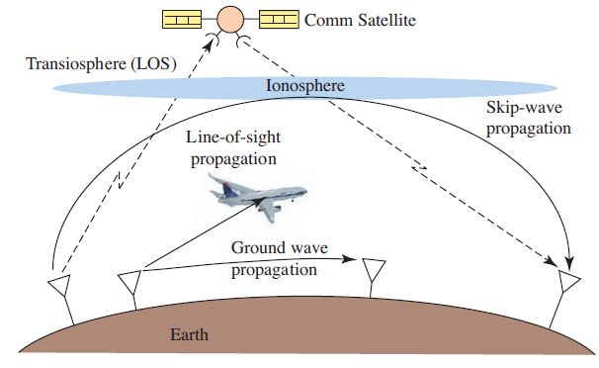
Propagation of electromagnetic waves

Slide 19
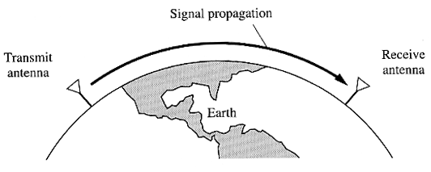
Ground wave Propagation
Below 2 MHz

Slide 20
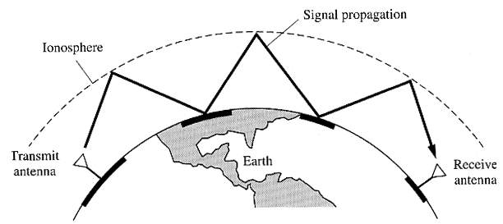
Sky Wave Propagation
2 to 30 MHz

Slide 21
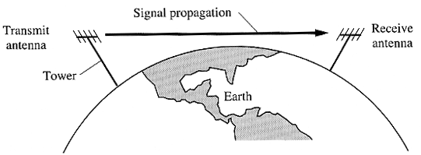
Line of sight propagation
Above 30 MHz

Slide 22
The Electromagnetic Frequency Spectrum

Slide 23
The Electromagnetic Frequency Spectrum
Frequency Ranges from 30 Hz to 300 GHz
Extremely Low Frequencies (ELF) | 30–300 Hz.
Voice Frequencies (VF) | 300–3400 Hz.
Very Low Frequencies (VLF) | include the higher end of the human hearing range up to about 20 kHz.
Low Frequencies (LF) | 30–300 kHz.
Medium Frequencies (MF) | 300–3000 kHz AM radio 535–1605 kHz.

Slide 24
The Electromagnetic Spectrum
High Frequencies (HF) (short waves; VOA, BBC broadcasts; government and military two-way communication; amateur radio, CB. | 3–30 MHz
Very High Frequencies (VHF) FM radio broadcasting (88–108 MHz), television channels 2–13. | 30–300 MHz
Ultra High Frequencies (UHF) TV channels 14–67, cellular phones, military communication. | 300–3000 MHz
Microwaves and Super High Frequencies (SHF) Satellite communication, radar, wireless LANs, microwave ovens | 1–30 GHz
Extremely High Frequencies (EHF) Satellite communication, computer data, radar | 30–300 GHz

Slide 25
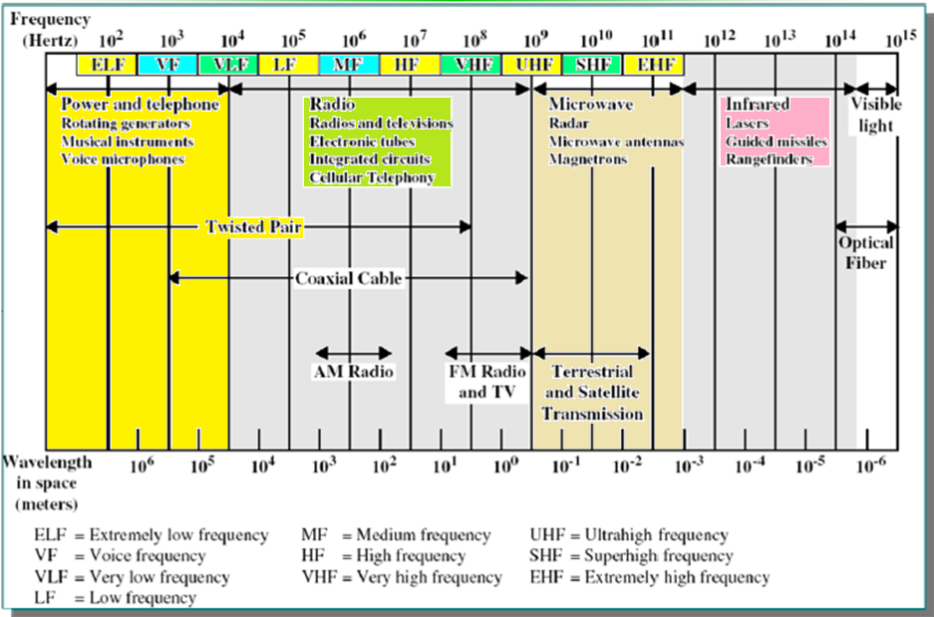
The Electromagnetic Spectrum

Slide 26
Objectives of Communications System Design
Two primary resources in communications
Transmitted power
Channel bandwidth (very expensive in the commercial market)
In certain scenarios, one resource may be more important than the other
Power limited (e.g. deep-space communication)
Bandwidth limited (e.g. telephone circuit)

Slide 27
End

